Slide 1

HUNGER BUSTERS
2024
2024

Slide 2

INTRODUCTION
2024
Hunger Busters is an initiative aimed at achieving Zero Hunger through innovative and collaborative food sharing. By promoting community empowerment
HUNGER BUSTERS

Slide 3
METHODOLOGY
2024
FRONTEND
React Native (Expo): Cross-platform mobile development.
Tailwind CSS: For responsive UI design.
BACKEND
Node.js & Express: RESTful API for handling server logic.
MongoDB: NoSQL database for storing user and donation data.
PAYMENTS
Stripe: Integrated for secure payment processing and subscription management.
HUNGER BUSTERS

Slide 4
MAIN FEATURES
01
02
03
04
20XX
FOOD QUALITY ANALYSIS
FOOD DONATION SYSTEM
SURPLUS FOOD LISTING
RECIPE SHARING AND NUTRITION DETAILS

Slide 5

01
EXPERTS DASHBOARD
2022
HUNGER BUSTERS

Slide 6
EXPERTS
USERS
20XX
Approve or Reject Pending Food Requests
Access Advanced Analytics Data
Earn Certification For Contribution
Receive Quality Food Approved By Experts

Slide 7
02
DONATION SYSTEM
2022
HUNGER BUSTERS

Slide 8

DONATION SYSTEM
20XX
Request Donation – School Donation and Elder Home Donation
Admin Review And Approval
Donation Subscription – Monthly or Annual Donation Plans

Slide 9
03
NUTRITION DETAILS
2024
HUNGER BUSTERS

Slide 10
NUTRITION DETAILS
2024
Admin posts food items along with nutritional details
Users can view food items and their nutritional information

Slide 11
03
RECIPES SHARING
2024
PART 2
HUNGER BUSTERS

Slide 12
RECIPES SHARING
2024
Admin posts food recipes along with nutritional details
View recipes - Prep Time, Serving Size, Ingredients, Instructions, and YouTube video for how to prepare the dish And Nutritional details

Slide 13
04
FOOD LISTING
2022
For Users
HUNGER BUSTERS

Slide 14
Surplus Food Listing
20XX
Post a Food Item for Pick-up– Up-for-Grabs for anyone who needs it.
View Donations – Donations Made by Anyone with excess food that can be donated.
Useful to help prevent food waste!

Slide 15
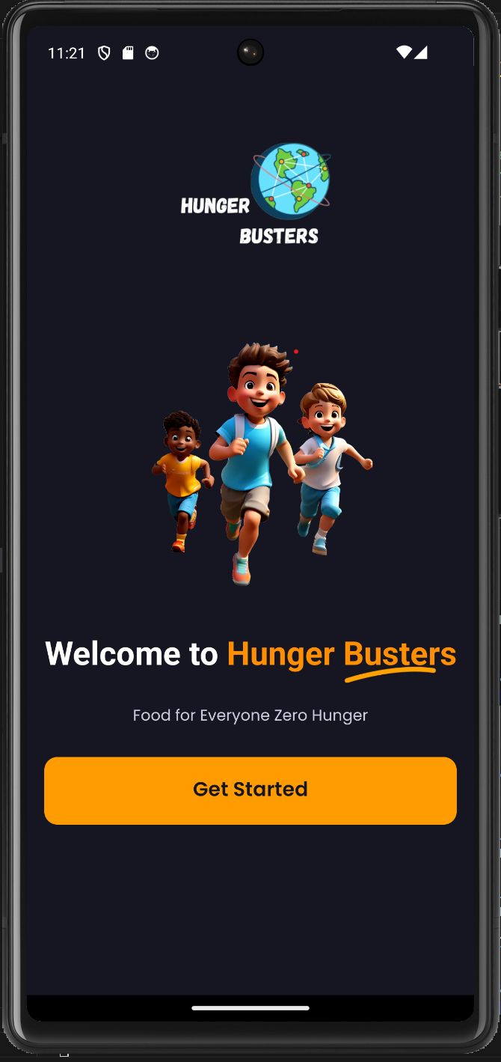
PRODUCT DEMO
2024
For
HUNGER BUSTERS
HUNGER BUSTERS

Slide 16

Thank You !
2024
HUNGER BUSTERS
HUNGER BUSTERS

